Slide 1

CTeSP Tecnologias e Programação de Sistemas de Informação
Segurança Informática
Filipe André Martins de Freitas

Slide 2
Firewall Technologies
Upon completion of this section, you should be able to:
Explain how firewalls are used to help secure networks.
Describe the various types of firewalls.
Configure a classic firewall.
Explain design considerations for implementing firewall technologies.

Slide 3
Securing Networks with Firewalls

Slide 4
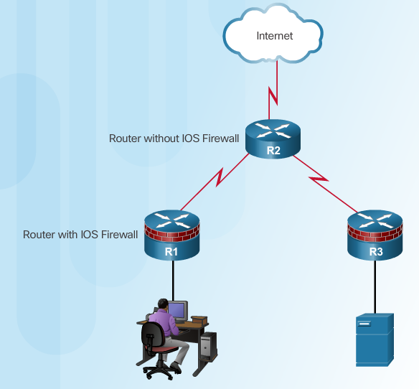
Defining Firewalls
All firewalls:
Are resistant to attack
Are the only transit point between networks because all traffic flows through the firewall
Enforce the access control policy
Notes:
4.2.1.1 Defining Firewalls

Slide 5
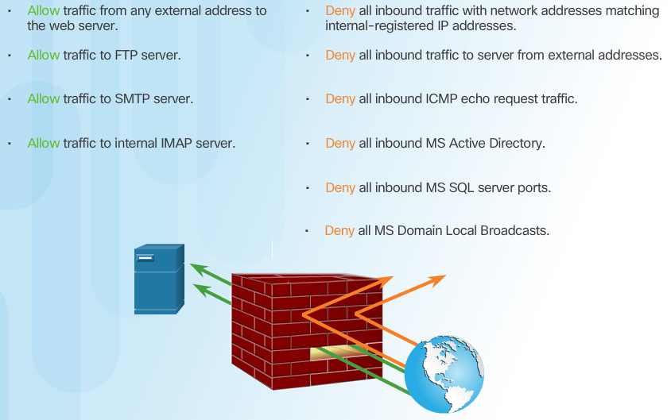
Benefits and Limitations of Firewalls
Notes:
4.2.1.2 Benefits and Limitations of Firewalls

Slide 6
Types of Firewalls

Slide 7
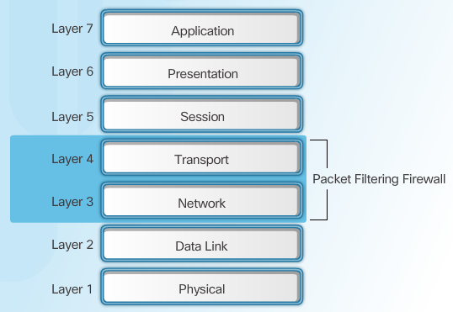
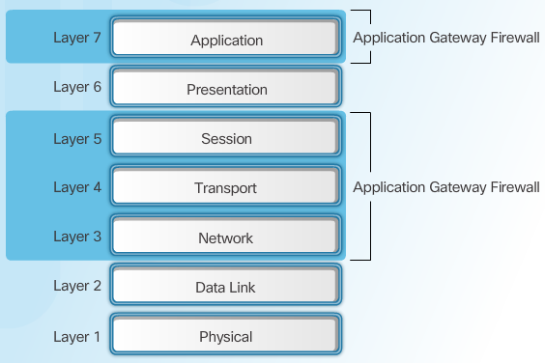
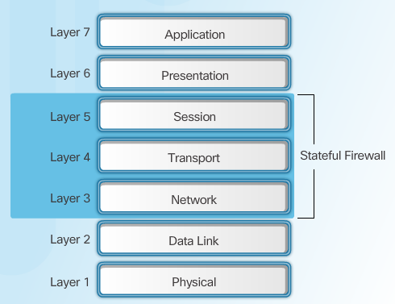
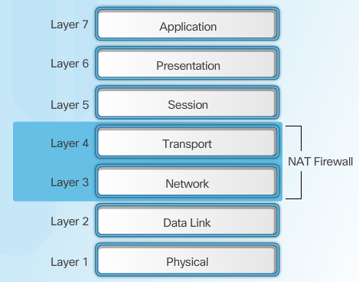
Firewall Type Descriptions
Packet Filtering Firewall
Application Gateway Firewall
Stateful Firewall
NAT Firewall
Notes:
4.2.2.1 Firewall Type Descriptions

Slide 8
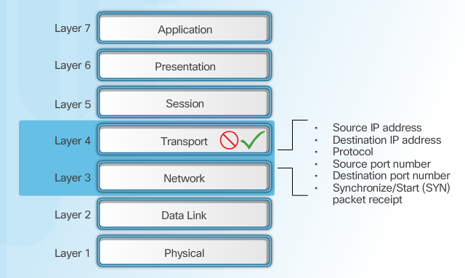
Packet Filtering Firewall Benefits & Limitations
Notes:
4.2.2.2 Packet Filtering Firewall Benefits and Limitations

Slide 9
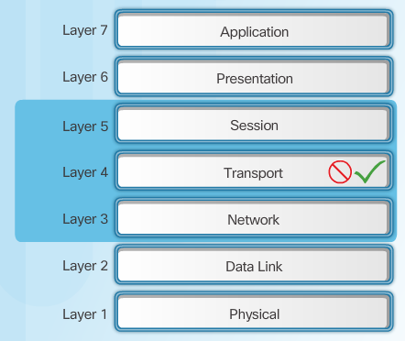
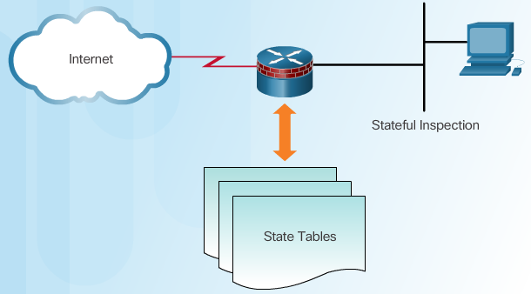
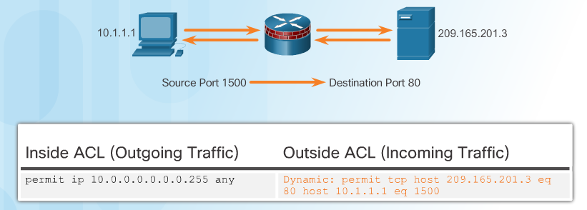
Stateful Firewalls
Stateful Firewalls
State Tables
Stateful Firewall Operation
Notes:
4.2.2.3 Stateful Firewalls

Slide 10
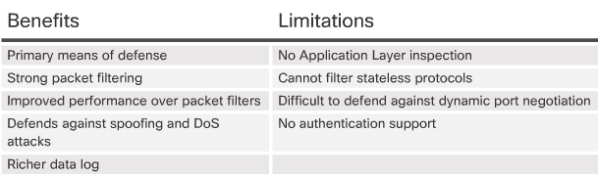
Stateful Firewall Benefits and Limitations
Next Generation Firewalls
Granular identification, visibility, and control of behaviors within applications
Restricting web and web application use based on the reputation of the site
Proactive protection against Internet threats
Enforcement of policies based on the user, device, role, application type, and threat profile
Performance of NAT, VPN, and SPI
Use of an IPS
Notes:
4.2.2.4 Stateful Firewall Benefits and Limitations
4.2.2.5 Next Generation Firewalls
4.2.2.6 Video Tutorial - Cisco ASA with FirePOWER Services
4.2.2.7 Activity - Identify the Type of Firewall

Slide 11
Classic Firewall

Slide 12
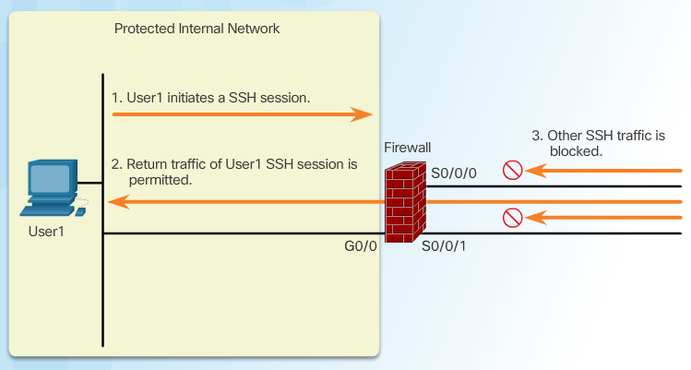
Introducing Classic Firewall
Notes:
4.2.3.1 Introducing Classic Firewall

Slide 13
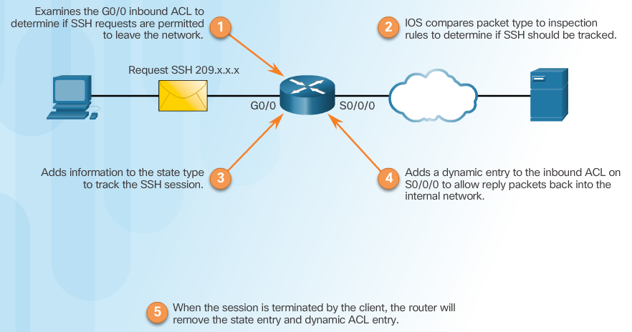
Classic Firewall Operation
Notes:
4.2.3.2 Classic Firewall Operation

Slide 14
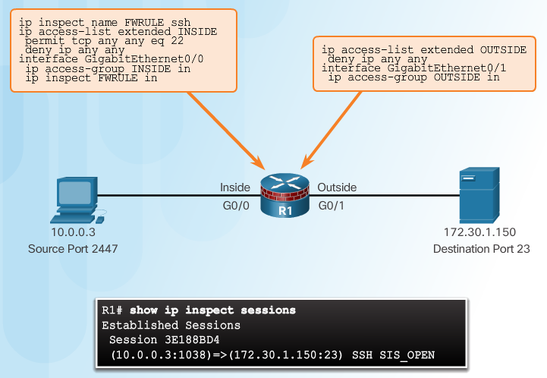
Classic Firewall Configuration
Choose the internal and external interfaces.
Configure ACLs for each interface.
Define inspection rules.
Apply an inspection rule to an interface.
Inspection Rules
Notes:
4.2.3.3 Classic Firewall Configuration

Slide 15
Firewalls in Network Design

Slide 16
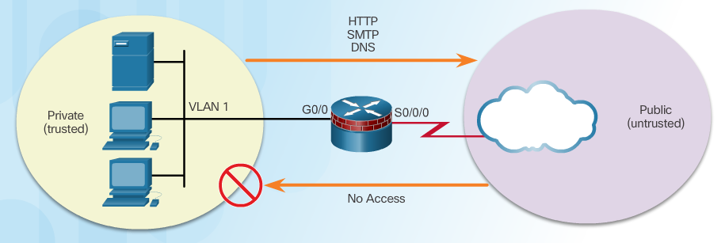
Inside and Outside Networks
Notes:
4.2.4.1 Inside and Outside Networks

Slide 17
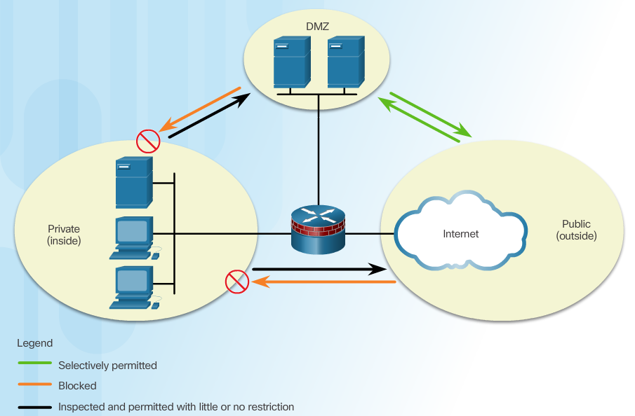
Demilitarized Zones
Notes:
4.2.4.2 Demilitarized Zones

Slide 18
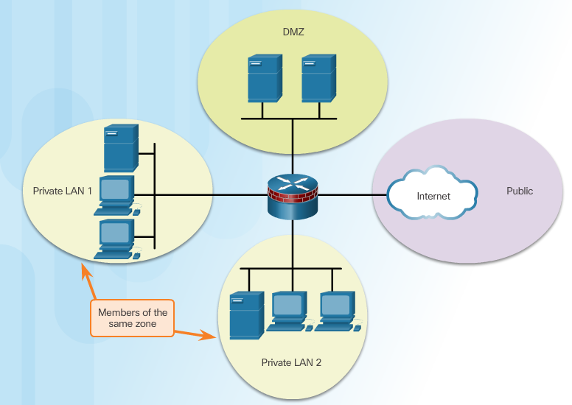
Zone-Based Policy Firewalls
Notes:
4.2.4.3 Zone-Based Policy Firewalls

Slide 19
Layered Defense
Considerations for network defense:
Network core security
Perimeter security
Endpoint security
Communications security
Firewall best practices include:
Position firewalls at security boundaries.
It is unwise to rely exclusively on a firewall for security.
Deny all traffic by default. Permit only services that are needed.
Ensure that physical access to the firewall is controlled.
Monitor firewall logs.
Practice change management for firewall configuration changes.
Remember that firewalls primarily protect from technical attacks originating from the outside.
Notes:
4.2.4.4 Layered Defense

Slide 20
Zone-Based Policy Firewalls
Upon completion of this section, you should be able to:
Explain how Zone-Based Policy Firewalls are used to help secure a network.
Explain the operation of a Zone-Based Policy Firewall.
Configure a Zone-Based Policy Firewall with CLI.

Slide 21
Zone-Based Policy Firewall Overview

Slide 22
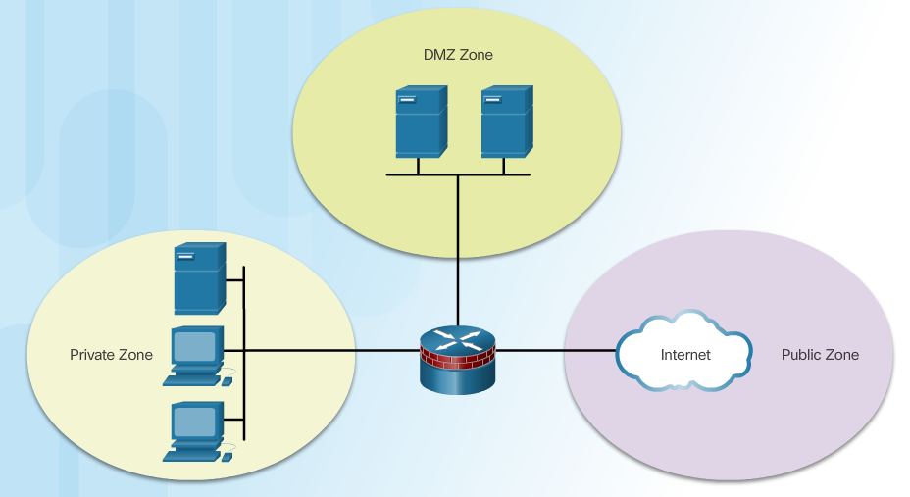
Benefits of ZPF
Not dependent on ACLs
Router security posture is to block unless explicitly allowed
Policies are easy to read and troubleshoot with C3PL
One policy affects any given traffic, instead of needing multiple ACLs and inspection actions
Notes:
4.3.1.1 Benefits of ZPF

Slide 23
ZPF Design
Common designs include:
LAN-to-Internet
Firewalls between public servers
Redundant firewalls
Complex firewalls
Design steps:
Determine the zones
Establish policies between zones
Design the physical infrastructure
Identify subsets within zones and merge traffic requirements
Notes:
4.3.1.2 ZPF Design
4.3.1.3 Activity - Compare Classic Firewall and ZPF Operation

Slide 24
ZPF Operation

Slide 25
ZPF Actions
Inspect - Configures Cisco IOS stateful packet inspections.
Drop - Analogous to a deny statement in an ACL. A log option is available to log the rejected packets.
Pass - Analogous to a permit statement in an ACL. The pass action does not track the state of connections or sessions within the traffic.
Notes:
4.3.2.1 ZPF Actions

Slide 26
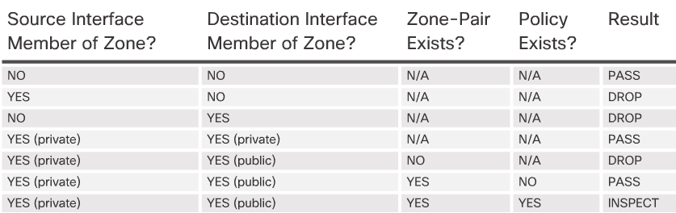
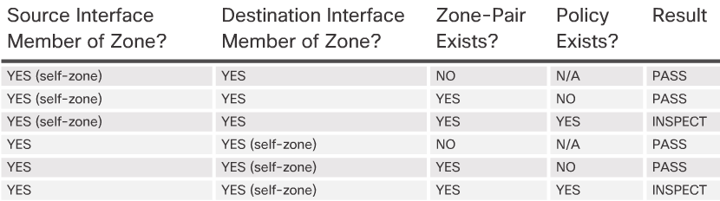
Rules for Transit Traffic
Rules for Traffic to the Self Zone
Notes:
4.3.2.2 Rules for Transit Traffic
4.3.2.3 Rules for Traffic to the Self Zone
4.3.2.4 Activity - Rules for Transit Traffic

Slide 27
Configuring a ZPF

Slide 28
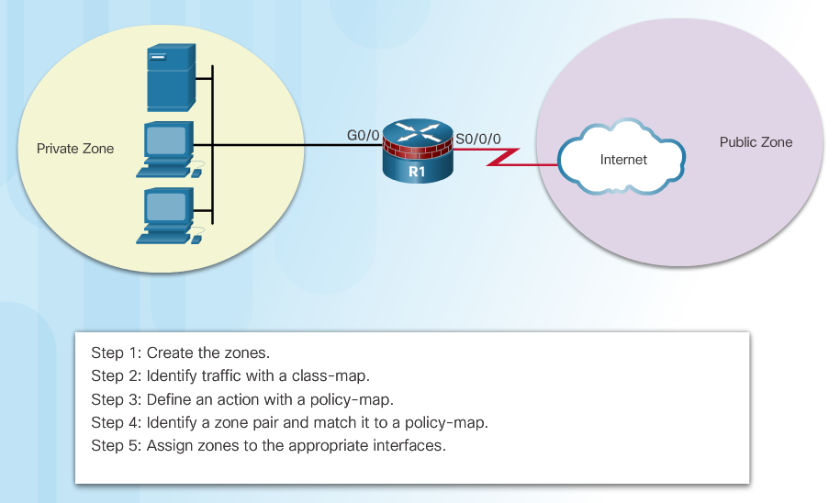
Configure ZPF
Notes:
4.3.3.1 Configure ZPF

Slide 29
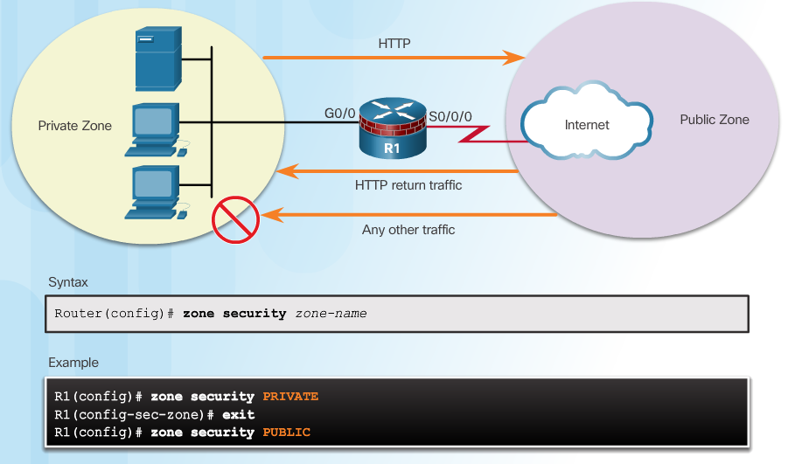
Step 1: Create Zones
Notes:
4.3.3.2 Create Zones

Slide 30
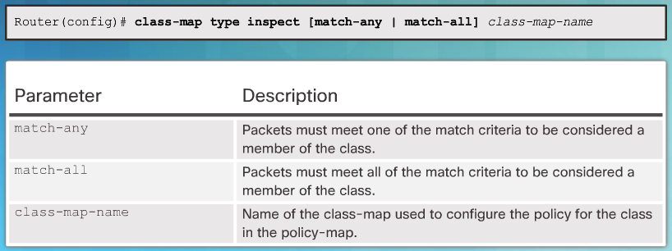
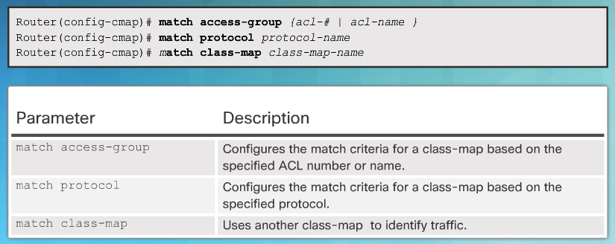
Step 2: Identify Traffic
Command Syntax for class-map
Sub-Configuration Command Syntax for class-map
Notes:
4.3.3.3 Identify Traffic

Slide 31
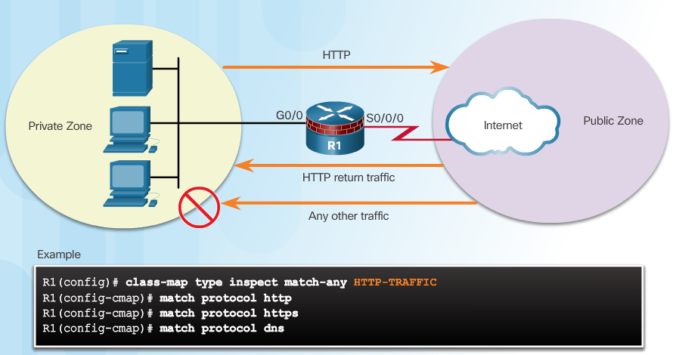
Step 2: Identify Traffic (Cont.)
Example class-map Configuration
Notes:
4.3.3.3 Identify Traffic

Slide 32
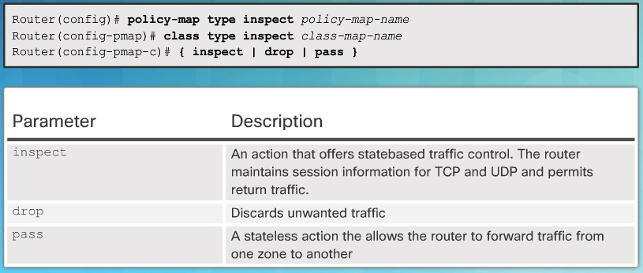
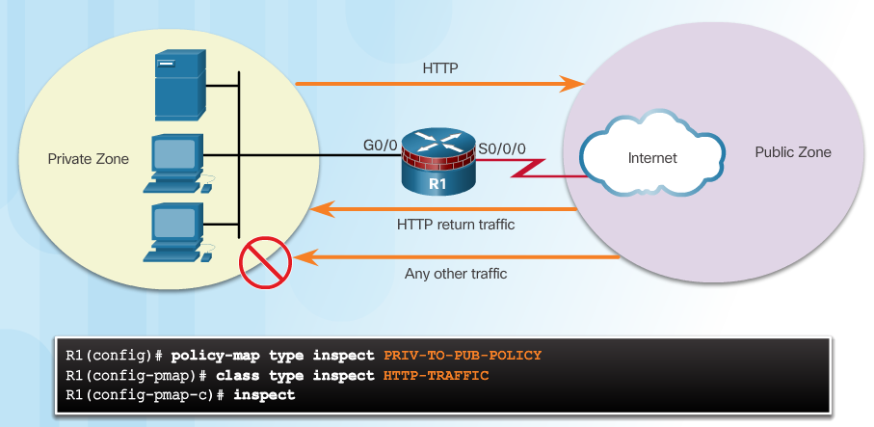
Step 3: Define an Action
Command Syntax for policy-map
Example policy-map Configuration
Notes:
4.3.3.4 Define an Action

Slide 33
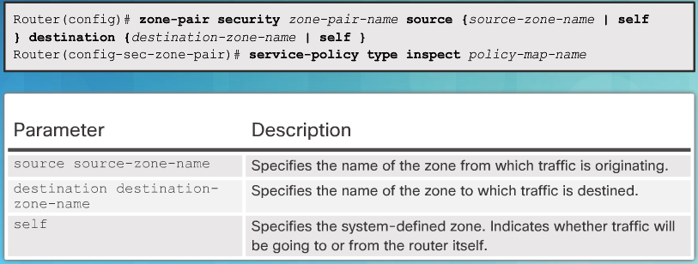
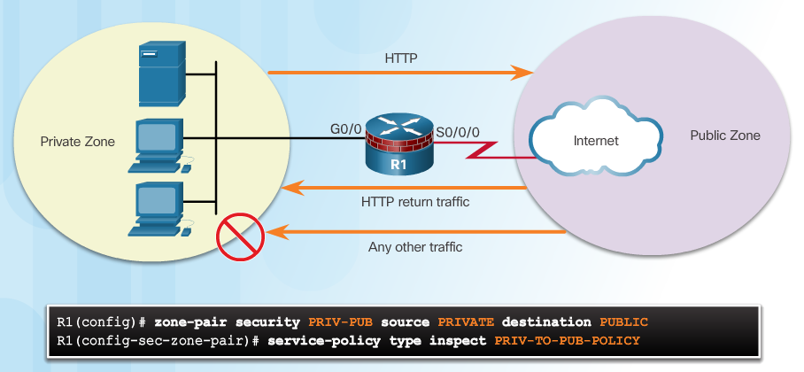
Step 4: Identify a Zone-Pair and Match to a Policy
Command Syntax for zone-pair and service-policy
Example service-policy Configuration
Notes:
4.3.3.5 Identify a Zone-Pair and Match to a Policy

Slide 34
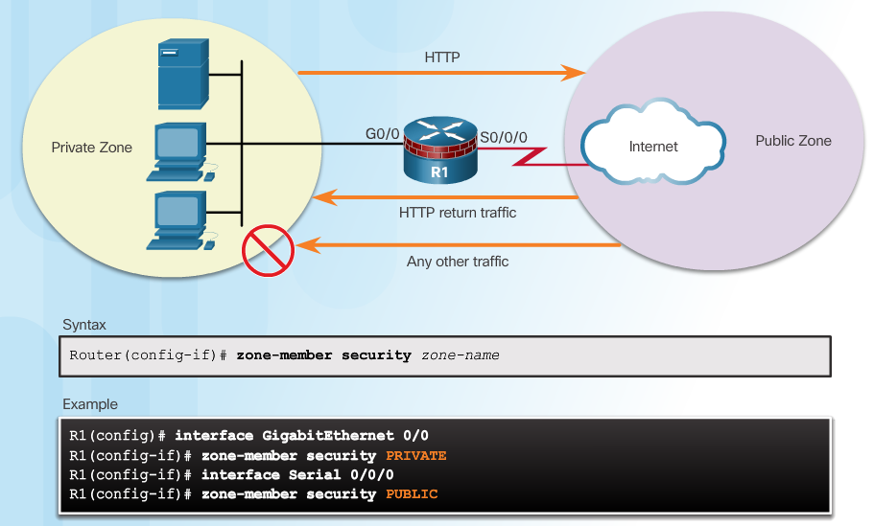
Step 5: Assign Zones to Interfaces
Notes:
4.3.3.6 Assign Zones to Interfaces

Slide 35
Verify a ZPF Configuration
Verification commands:
show run | begin class-map
show policy-map type inspect zone-pair sessions
show class-map type inspect
show zone security
show zone-pair security
show policy-map type inspect
ZPF Configuration Considerations
No filtering is applied for intra-zone traffic
Only one zone is allowed per interface.
No Classic Firewall and ZPF configuration on same interface.
If only one zone member is assigned, all traffic is dropped.
Only explicitly allowed traffic is forwarded between zones.
Traffic to the self zone is not filtered.
Notes:
4.3.3.7 Verify a ZPF Configuration
Syntax Checker - Configure Zone-Based Policy Firewall with CLI
4.3.3.8 ZPF Configuration Considerations
4.3.3.9 Video Demonstration - ZPFs

Slide 36
DÚVIDAS ?!

Slide 37


